Slide 1
REFERENCE PPT — PLEASE READ
The PPTs shown in the following slides are ONLY REFERENCE.
These are from a WINNING TEAM of Smart India Hackathon 2025.
DO NOT COPY IT DITTO.
You do NOT have to make your PPT exactly like this.
Understand the approach, then create it according to YOUR problem statement and YOUR solution.
Take the INSPIRATION → Build YOUR OWN STORY, DIAGRAMS & CONTENT.

Slide 2
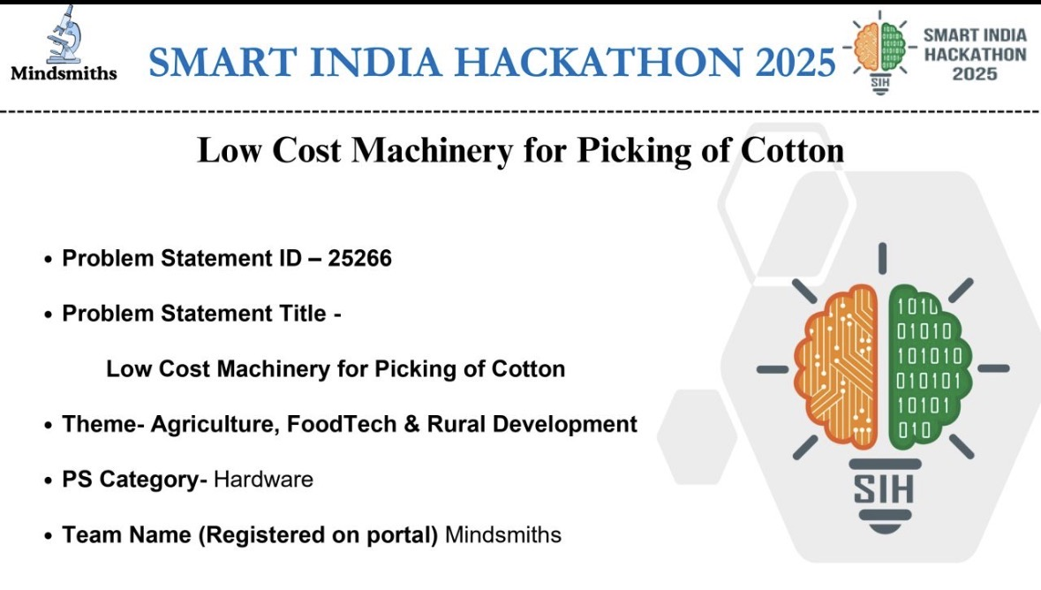
REFERENCE 1 — Cover / Problem Statement: how to introduce the problem statement, theme, category and team.

Slide 3
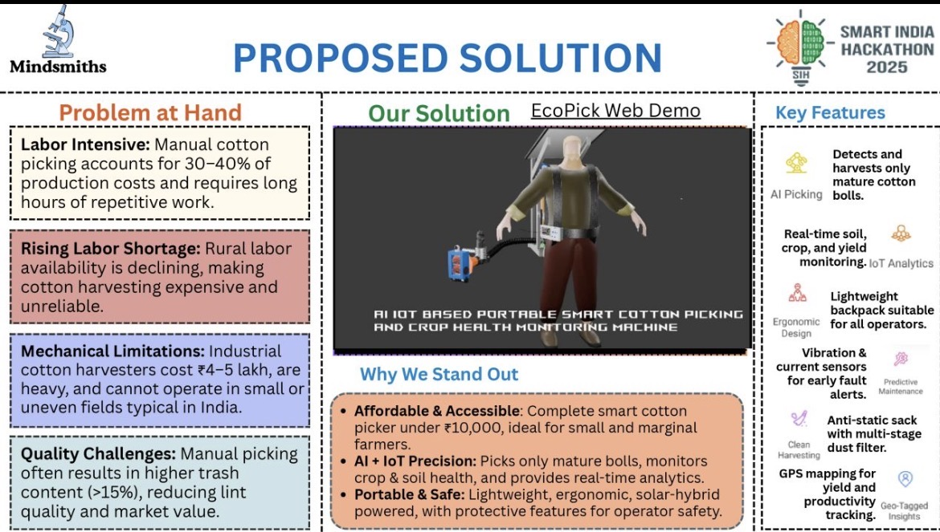
REFERENCE 2 — Proposed Solution: problem → solution → key features → why the approach stands out.

Slide 4
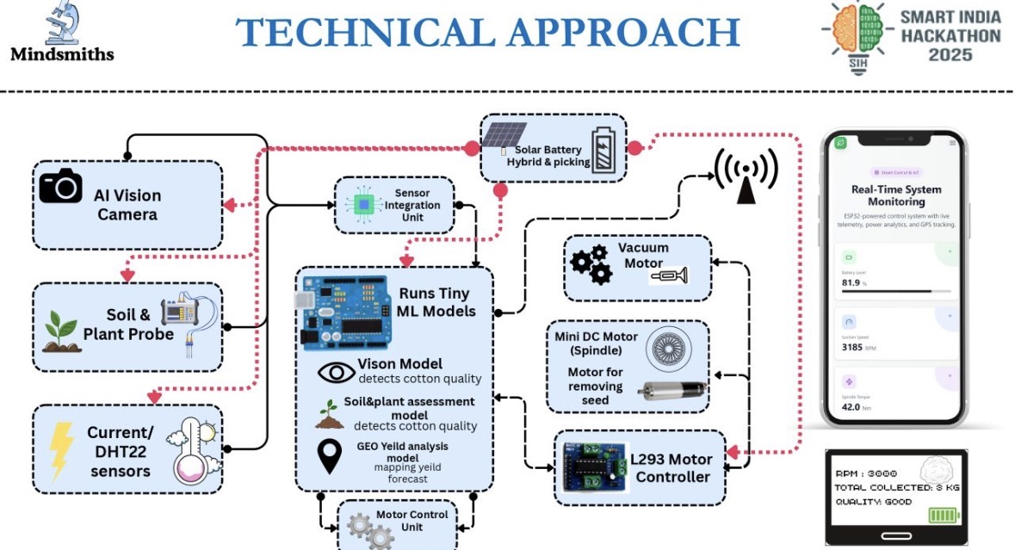
REFERENCE 3 — Technical Approach: how to draw a complete technical architecture with inputs, processing, hardware/software and outputs.

Slide 5
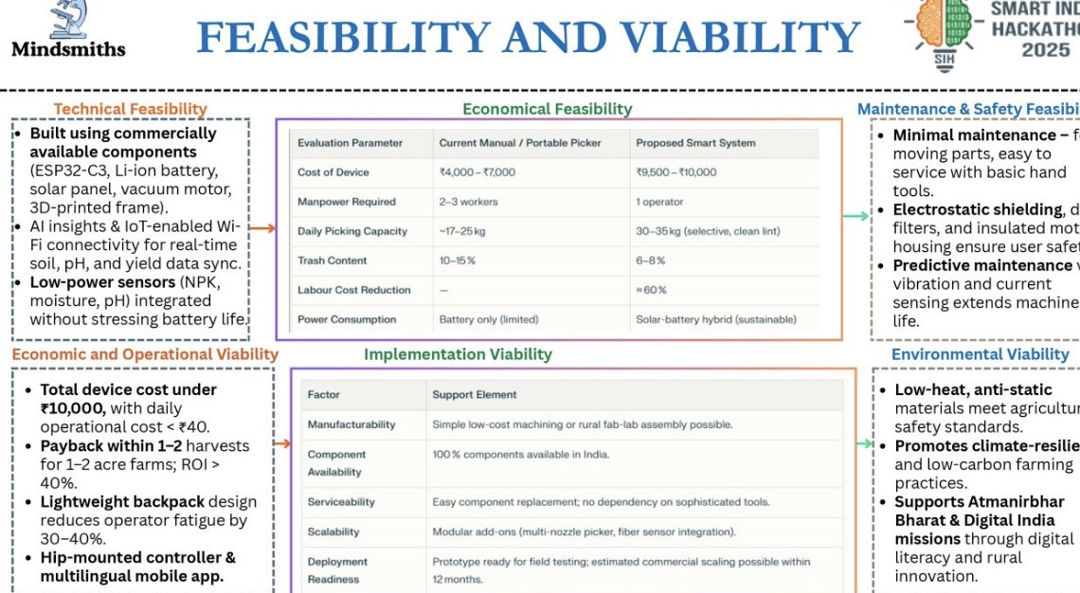
REFERENCE 4 — Feasibility & Viability: how to present technical, economic, operational, maintenance, safety and environmental feasibility.

Slide 6
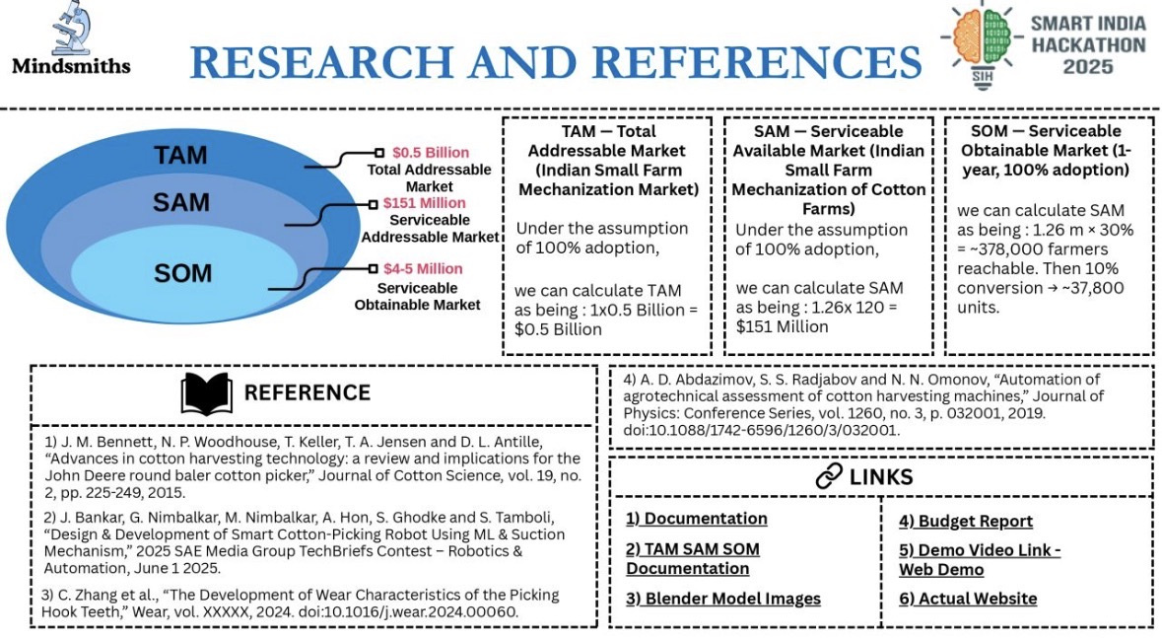
REFERENCE 5 — Research & References: how to show market/research evidence, TAM–SAM–SOM, references and useful links.

